Slide 1
HUMAN COMPUTER INTERACTION (hci)
VELLORE INSTITUTE OF TECHNOLOGIES - CHENNAI
Done By -
AKSHAY E – 20MIS1177

Slide 2
TITLE OF THE PROJECT
Hand Gesture Recognition
(Recognition of Hand Movement for a Paralytic Person Using Convolutional Neural Network)

Slide 3
AGENDA
INTRODUCTION LITERATURE SURVEY NOVELTY ARCHITECTURE DIAGRAM OUTPUT

Slide 4
INTRODUCTION
According to the Indian statistics, the stroke rate is higher compared to other countries. It is approximately 1.8 million Indians out of 1.2 billion Indians suffering from stroke every year. As a result of this brain cells get damaged which leads to paralysis. To help the stroke patients out of its researchers have found a solution by creating hand gestures that will help them perform daily functions easily. The gesture made by hand will be the input instead of a mouse or keyboard. The main aim is to read and detect the hand gestures by using high-resolution cameras and process the images using convolution neural networks by the process of edge detection

Slide 5
LITERATURE SURVEY

Slide 6
Title | Author | Year of Publication | Abstract
Hand Gesture Recognition: A Literature Review | Rafiqul Zaman Khan Noor Ibraheem | 2020 | Hand gesture recognition system received great attention in the recent few years because of its manifoldness applications and the ability to interact with machine efficiently through human computer interaction. In this paper a survey of recent hand gesture recognition systems is presented.
Research on the Hand Gesture Recognition Based on Deep Learning | Jing-Hao Sun Ting-Ting Ji Shu-Bin Zhang Jia-Kui Yang Guang-Rong Ji | 2022 | With the rapid development of computer vision, the demand for interaction between human and machine is becoming more and more extensive. Since hand gestures are able to express enriched information, the hand gesture recognition is widely used in robot control, intelligent furniture and other aspects. The paper realizes the segmentation of hand gestures by establishing the skin color model and AdaBoost classifier based on haar according to the particularity of skin color for hand gestures, as well as the denaturation of hand gestures with one frame of video being cut for analysis.

Slide 7
Title | Author | Year of publication | Abstract
Hand Gesture Recognition System based in Computer Vision and Machine Learning | Paulo Trigueiros Fernando Ribeiro Luís Paulo Reis | 2021 | Hand gesture recognition is a natural way of human computer interaction and an area of very active research in computer vision and machine learning. This is an area with many different possible applications, giving users a simpler and more natural way to communicate with robots/systems interfaces, without the need for extra devices.
Hand Gesture Recognition | HILWA KADER JERALD SIBY | 2023 | The most important methodology used for communication between hearing and speech impaired person is the sign language. So, it becomes a necessary task to create a bridge between the two persons who wants to communicate. Many algorithms have been developed in the recent years, to help people who are not aware of the sign language but very few with good results exist. The difficult part in the hand gesture recognition is the segmentation of the hand or segregation of the hand and identifying the hand gesture

Slide 8
Title | Author | Year of Publication | Abstract
Hand Gesture Recognition Based on Computer Vision: A Review of Techniques | Munir Oudah Ali Al-Naji Javaan Chahl | 2020 | Hand gestures are a form of nonverbal communication that can be used in several fields such as communication between deaf-mute people, robot control, human–computer interaction (HCI), home automation and medical applications. Research papers based on hand gestures have adopted many different techniques, including those based on instrumented sensor technology and computer vision. In other words, the hand sign can be classified under many headings, such as posture and gesture, as well as dynamic and static, or a hybrid of the two.

Slide 9
NOVELTY
Addressing a significant need: Stroke is a major health concern in India, impacting millions of people annually. This project directly addresses the need for improved assistive technology for stroke patients facing paralysis.
Leveraging advancements in machine learning: Utilizing high-resolution cameras and Convolutional Neural Networks (CNNs) for hand gesture recognition represents a modern and potentially effective approach.
Potential for customization and personalization: The ability to recognize individual hand gestures can lead to personalized interfaces tailored to each patient's specific needs and capabilities.
Potential for diverse applications: While targeting stroke patients initially, the underlying technology could have broader applications for individuals with limited mobility due to various conditions.

Slide 10
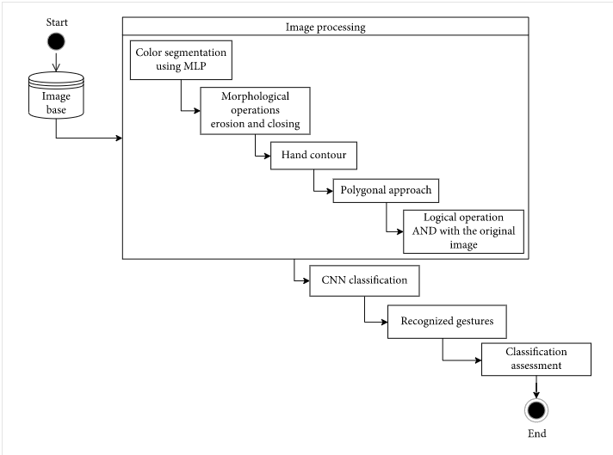
Architecture diagram

Slide 11
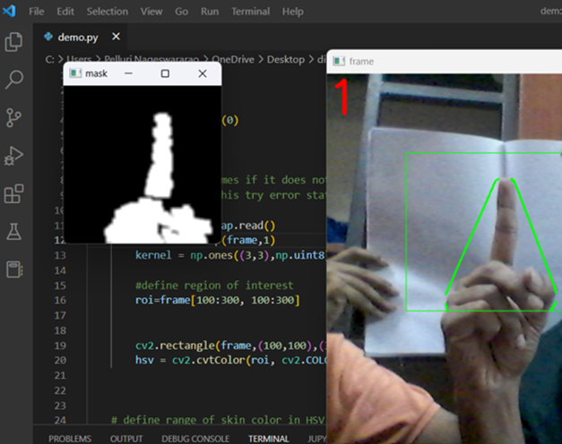
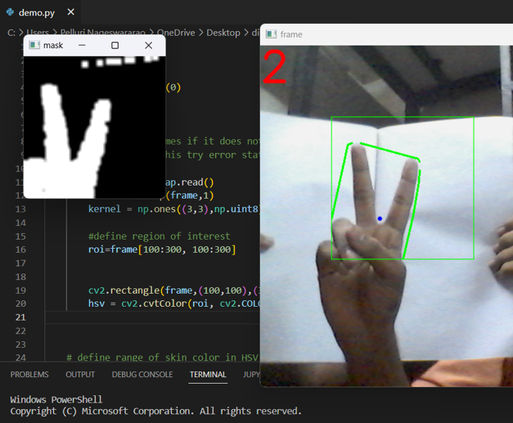
Outputs-

Slide 12
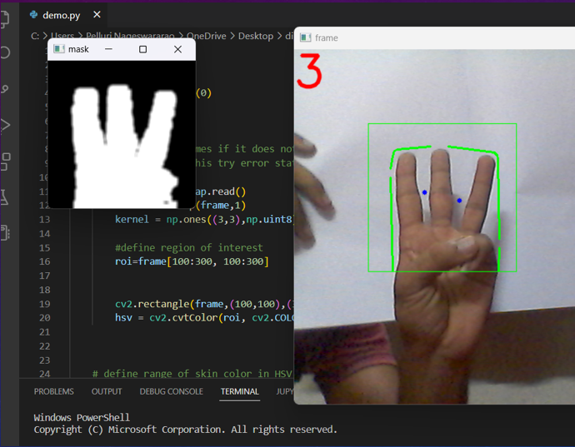
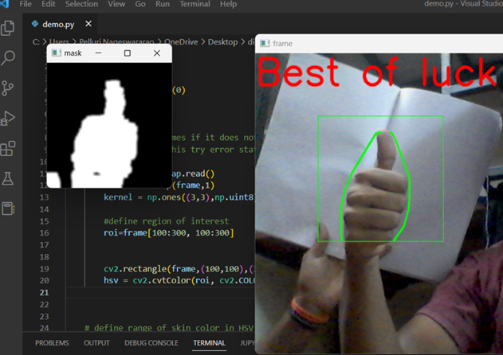
Outputs-

Slide 13
THANK YOU

